Slide 1
Gautam Adusumilli
Growth
Fortitude
Feeling Alive
Bravery
Patient Centered
Positivity
Productivity
Laughter

Slide 2
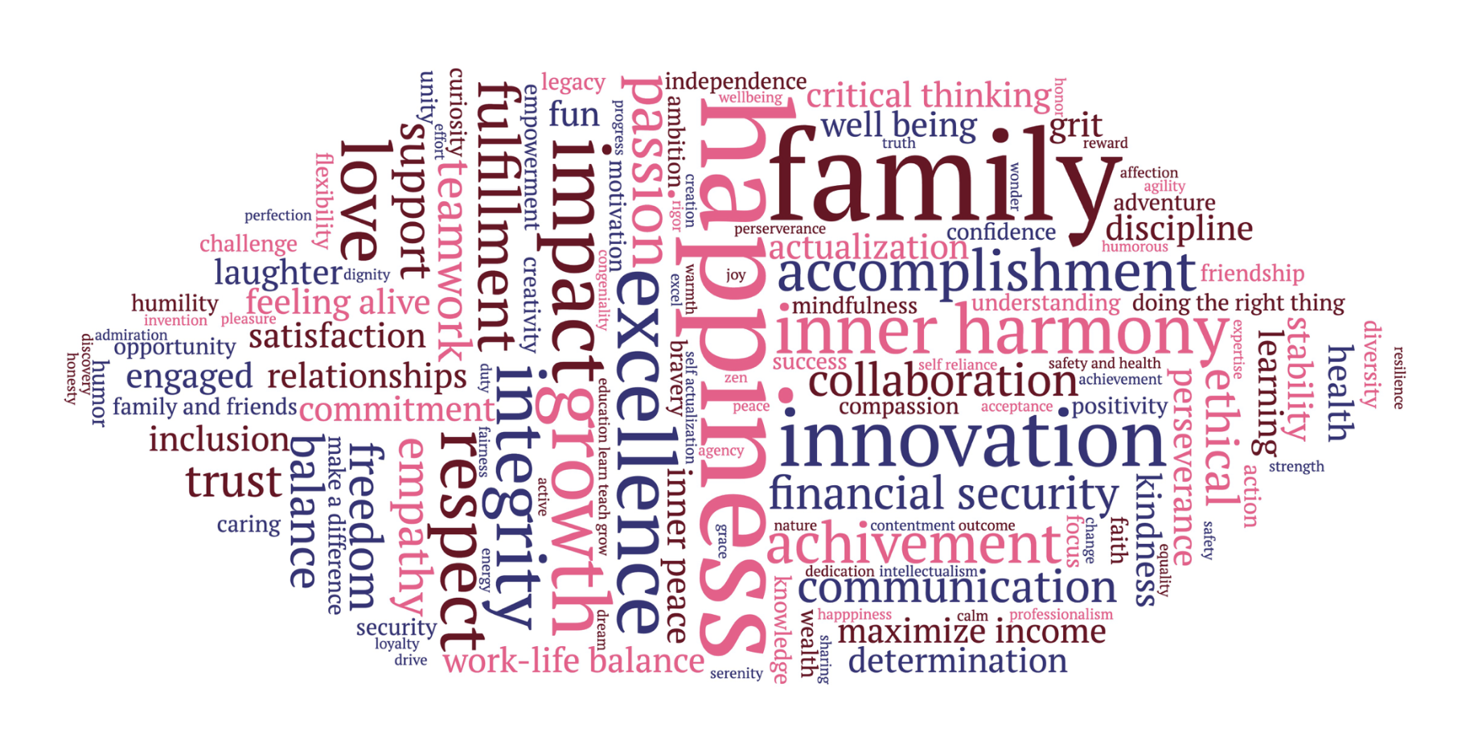

Slide 3
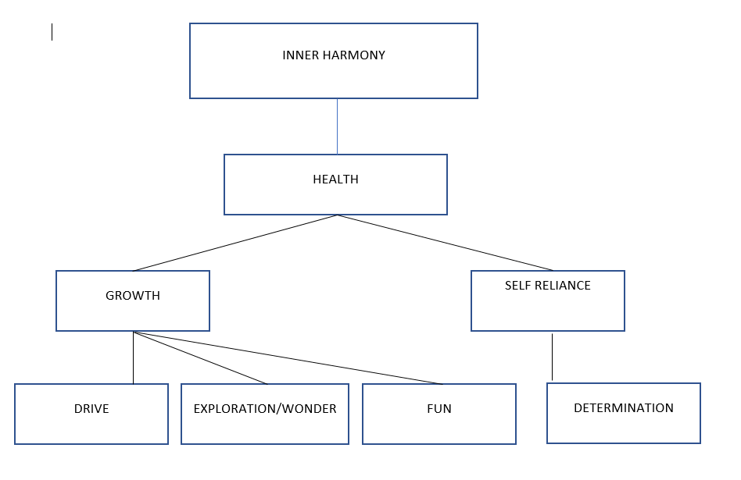
Miguel Alvear

Slide 5
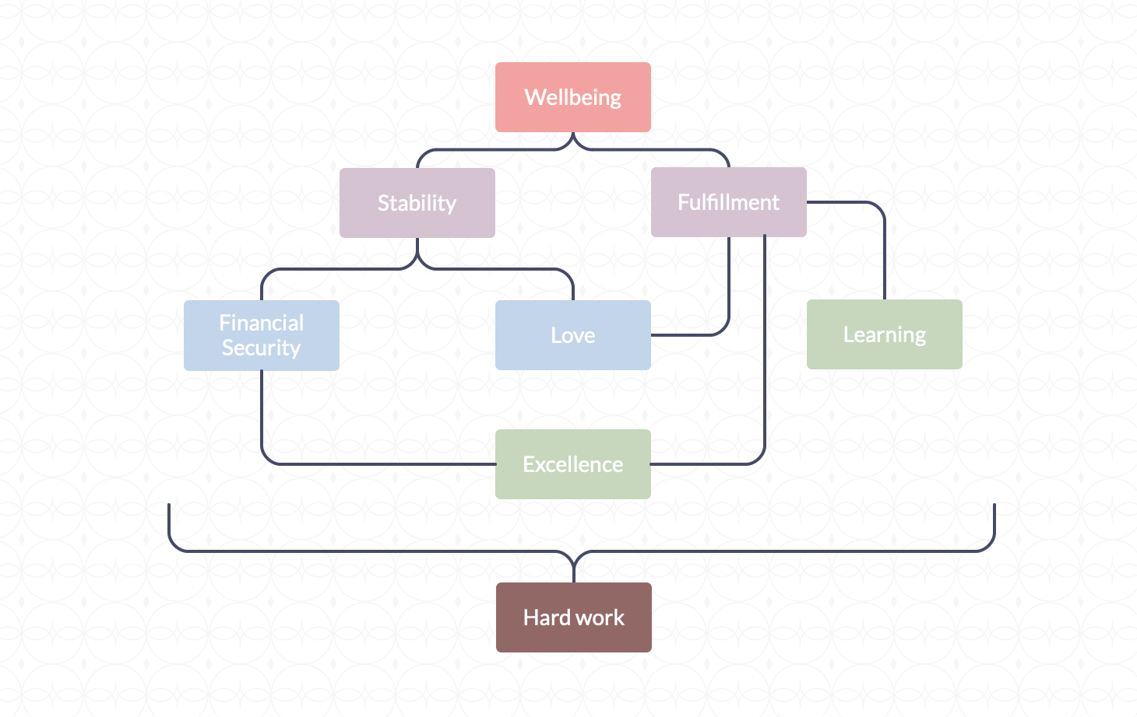
Jade Bassil

Slide 7
Derek Brookshire

Slide 9
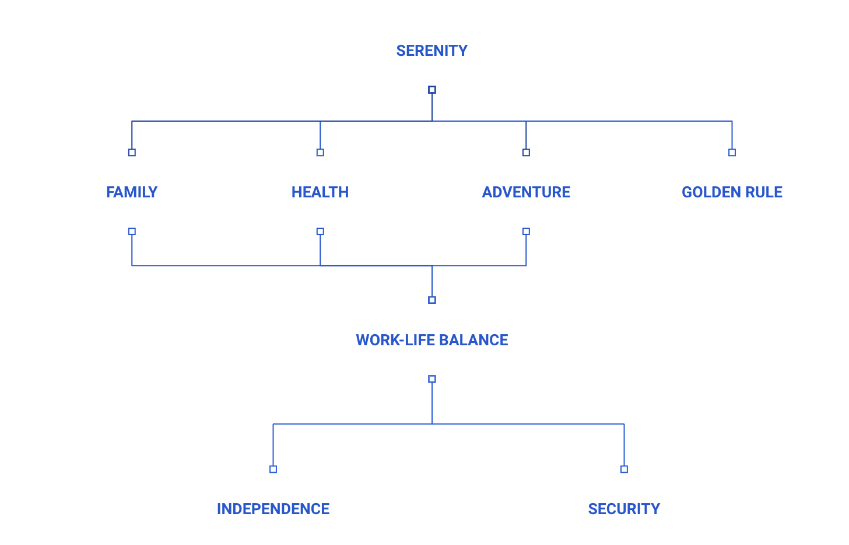
Tijana Bzenic

Slide 11
Hyewon Chung
Inner Peace
Balance
Self Entrance
Relationship
Achievement
Empowerment
Collaboration

Slide 13
Emily Davila
Equality
Integrity
Passion
Consistency
Opportunity
Understanding
Truth
Security

Slide 15
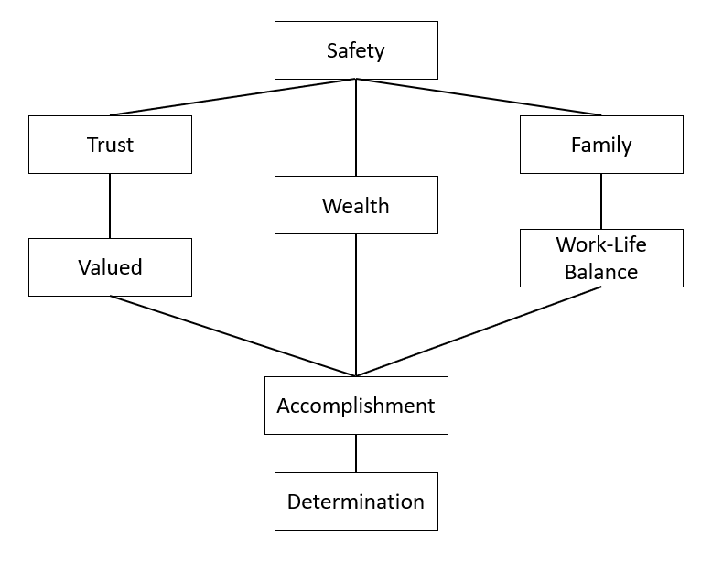
Sonia Donde

Slide 17
Yuchen Duan
Happiness
Family
Make Things
Better
Do The
Right Things
Health
Progress
Grit

Slide 19
Yoel Fainchtein Kaplan
Fulfillment
Peace
Work Life Balance
Maximize Income
Family
Transparency
Bravery
Growth

Slide 21
Jason Foster
Love
Freedom
Friends & Family
Impact
Health
strength
Impact
Critical Thinking

Slide 23
Mohit Gupta
Self Awareness
Duty
Outcomes
Engaged
Rigor
Valued
Inclusion
Adventure

Slide 25
Elijah Heyward
Integrity
Friends Family
Wonder
Love
Confident
Flexibility
Exuberance
Faith

Slide 27
William Hudson
Satisfaction
Accomplishment
Do The
Right Things
Maximize Income
Progress
Balance
Work
Family
Life
Opportunity
Collaborator

Slide 29
Sarah Hwang
Stability
Financial Security
Empowerment
Trust
Family
Diversity
Compassion
Mentoring

Slide 31
Reed Jarvis
Satisfaction
Family
Perfection
Dedication
Respect
Customer Centricity
Action
Communication

Slide 33
Lin Ju
Make a Difference
Ambition
Passion
Critical Thinking
Legacy
Engaged
Bravery
Accountability
Flexibility
Engaged

Slide 35
Jaehyun Kim
Inner Peace
Feeling Alive
Motivation
Family
Accomplishment
Expertise
Independence
Optimism

Slide 37
Alex Koh
Serenity
Resilience
Positivity
Accomplishment
Excellence
Motivation
Connected to The Universe
Fun

Slide 39
Richard Lee

Slide 41
Nicole Mandell
Feeling Alive
Growth
Family/ Relationship
Knowledge
Strong Work
Ethic
Playfulness
Empathy
Curiosity

Slide 43
Mallory Meiser
Laughter
Balance
Innovation
Challenge
Grace
Education
Agency
Support

Slide 45
Kelsey Moszkiewicz

Slide 47
Steven Mountzouris
Happiness
Help People
Humor
Impact
Collaboration
Challenge
Curiosity
Ethical

Slide 49
Hellen Nguyen
Actualization
Authenticity
Growth
Wellbeing
Adventure
Achievement
Freedom
Passion

Slide 51
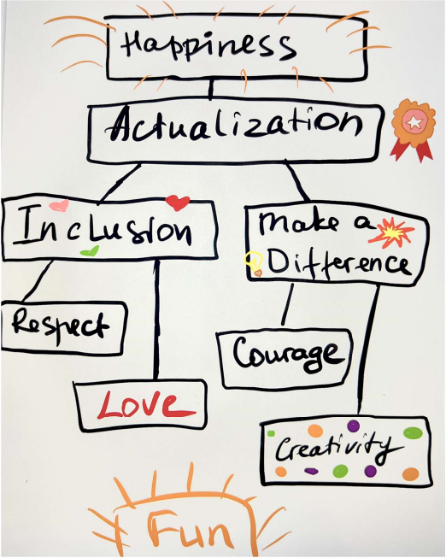
Lidia Novosad

Slide 53
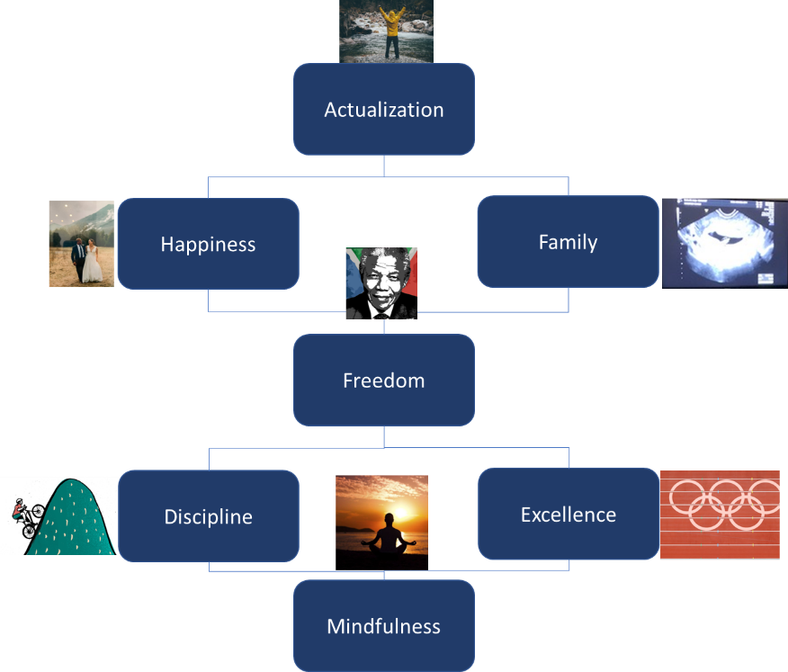
Lenny Pereira

Slide 55
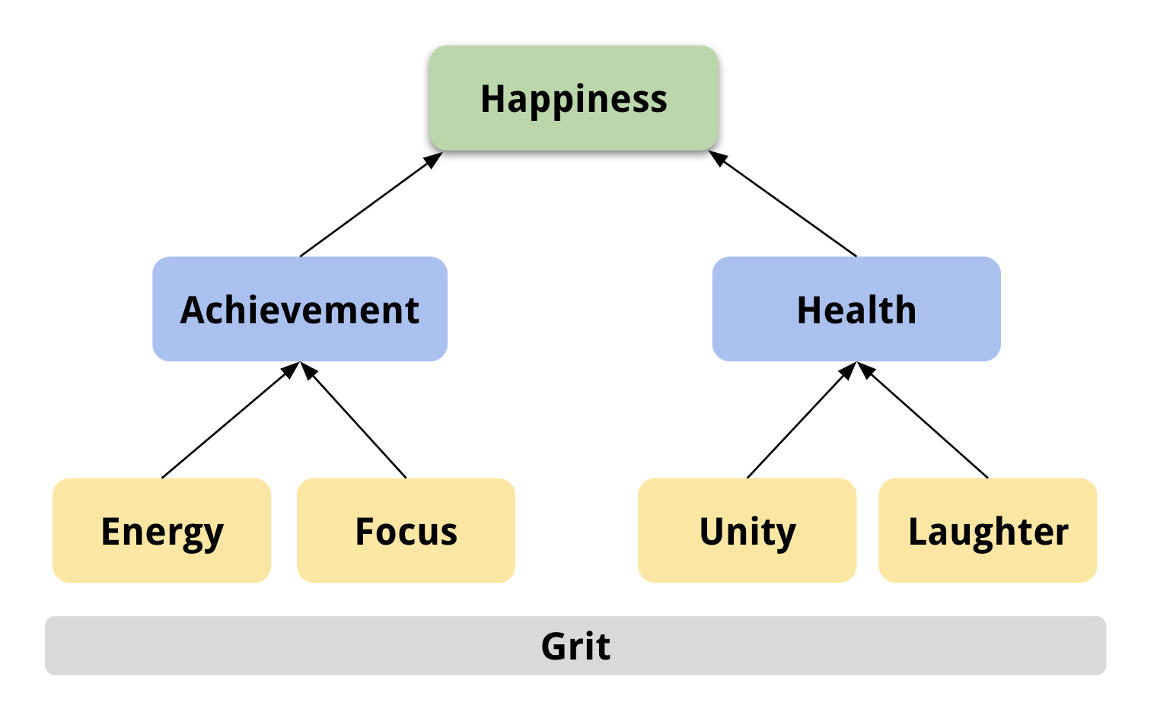
Derek Pires

Slide 57
Termpan Pitakbunkate
Inner Harmony
Warmth
Faith
Ethical
Understanding
Unity
Optimism
Work-Life
Balance

Slide 59
Joan Porta
Fulfillment
Making Things
Better
Family & friends
Integrity
Humility
Trust
Sharing

Slide 61
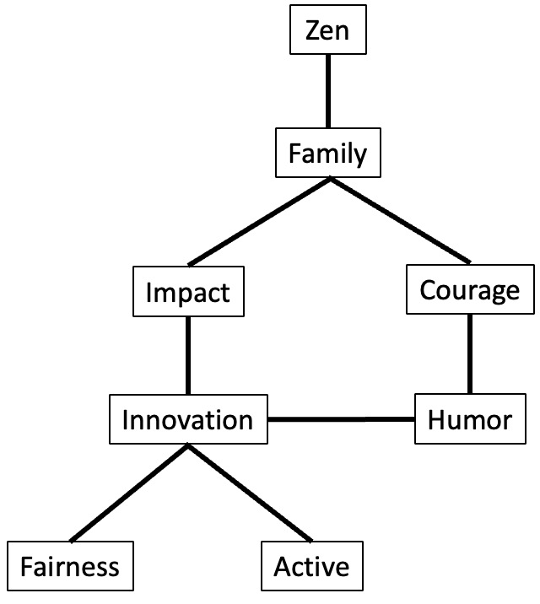
Aditya Ramamurthy

Slide 63
Julia Revina
Happiness
Fulfillment
Impact
Balance/ Family/ Work/ Life
Collaboration
Innovation
Passion
Legacy

Slide 65
David Reyes-Bastida
Notes:
不想洗了

Slide 67
Taylor Ryan
Notes:
不想洗了

Slide 69
Partha Sardar
Happiness
Change
Dream
Caving
Innovation
Commitment
Legacy
Acceptance

Slide 71
Mohammed Shammasi
Self - Actualization
Well-being
Achievement
Family &
Friends
Kindness
Respect
Reward
Leering

Slide 73
Cory Silverstein
Passion
Freedom
………………..
Well-being
…………
…………
Empathy
Respect

Slide 75
Ashley Steele
Significance
Perseverance
Invention
Achievement
Admiration
Financial Security
Dreaming

Slide 77
Yamicha Stephenson
Love
Transparency
Trust
Ethical
Professionalism
Critical Thinking
Strong Work
Intellectualism

Slide 79
Blake Stout
Inner Peace
Balance
Financial
Security
Relationship
Impact
Health
Respect

Slide 81
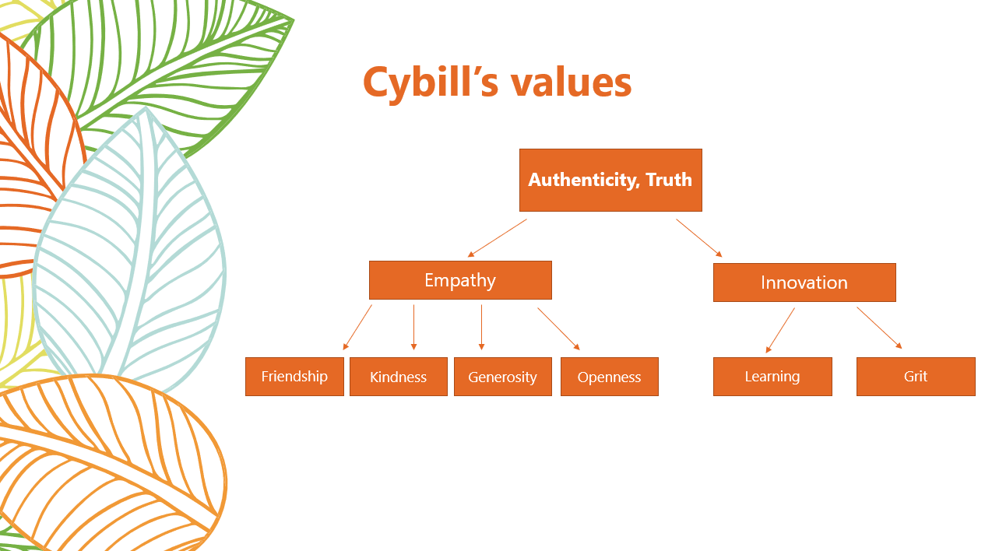
Cybill Su

Slide 83
Shun Tanaka
Happiness
Calm
Equanimity
Manual Beauty
Discipline
Confidence
Do The Right Things
Affirmative

Slide 85
Joyee To
Happiness
Growth
Mindfulness
Friendship
Knowledge
Creativity
Ethical
Diversity

Slide 87
Aigerim Tulepbergenova
Happiness
Independence
Staying Active
Family
Security
Getting the most out of Life
Positive Legacy
Wealth

Slide 89
Tyler Voigt
Happiness
Do the Right Things
Pleasure
Respect
Accomplishment
Team Work
Engaged
Commination
Effort

Slide 91
Mian Wang
Happiness
Excellence
Free Expression
Empowerment
Excel
Affection
Amorous
Action
Notes:
不想洗了

Slide 93
John Whalen
Inner harmony
Success
Relationship
Creation
Impact
Commitment
Support
Discovery

Slide 95
Bessie Zavidow
Satisfaction
Stability
Achievement
Family
Excellence
Team Work
Reliability
Determination

